Slide 1
SEO AUDIT AND OPTIMIZATION

Slide 4
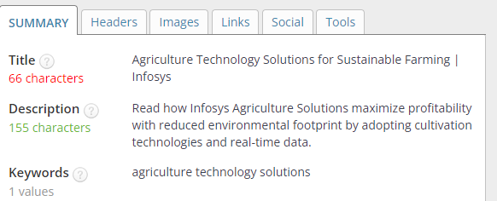
TASK 3
On-page SEO Optimization Audit:
WEB SITE LINK: https://www.infosys.com/industries/agriculture/overview.html

Slide 5
Title and meta description is optimized properly.
Keyword: Agriculture technology solutions
2.Keywords are not optimized properly. The keywords are used only twice.
3.INTERNAL LINKING AND EXTERNAL STRUCTURE:
There is no internal linking in this page.
4.Some of the images are not used Alt tabs and no images are not used Alt tabs with the target keyword. The file name of the image is used with the keyword Agriculture.

Slide 6
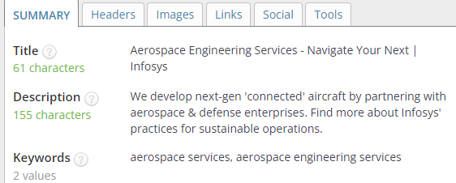
page 2
Link: https://www.infosys.com/industries/aerospace-defense/overview.html

Slide 7
1. The title meta description is optimized properly.
2.Keyword:Aerospace services, Aerospace Engineering
keywords are not optimized properly.
3.INTERNAL LINKING AND EXTERNAL STRUCTURE: There is no internal links in this page.
4.

